Slide 1
Dangerous Diseases that Affect the Human Body
Maricruz Lira, Michelle Orosco, Hilda Gomez, Aileen Casillas
_{Level 4}

Slide 2
Leukemia and the Nervous System

Slide 3
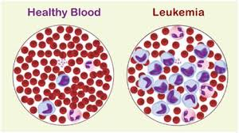
About Leukemia
A disease in which the bone marrow and other blood-forming organs produce immature or abnormal leukocytes.
Leukocytes - suppress the production of normal blood cells.
It is thought to occur when some blood cells acquire mutations in their DNA.
Certain abnormalities can cause the cell to grow & divide at a much faster rate, and also to continue living, when normal cells would just die off.
Throughout time, these cells can overcrowd the blood cells in the bone marrow, which leads to lower white blood cells, red blood cells and platelets.
Notes:
Leukocytes can actually lead to anemia and other symptoms.
Leukemia is also known as blood cancer.

Slide 4
Leukemia in the Nervous System
The nervous system is a network of nerve cells and fibers which transmits nerve impulses through the parts of the body.
Leukemia can find it’s way into the brain, through blood.
Most patients with AML (Acute Myelogenous Leukemia) have been found to have it spread into the CNS
The patient may experience seizures, problems with balance, problems with vision, and headaches.
In order to know if leukemia has spread to the central nervous system, the doctors may take a sample fluid from the lower part of the back.

Slide 5
Symptoms & Risk Factors
Symptoms:
Weakness or feeling tired.
Fever or night sweats.
Easy bruising or bleeding.
Pain in bones.
Having many infections.
Risk Factors:
Patients with AML
Chromosome 11 abnormality
Hyperleukocytosis: abnormal leukocytes

Slide 6
Treatments
Chemotherapy: Cancer treatment that uses drugs to stop the growth of cancer cells, by killing the cells or stopping them from dividing.
Radiation Therapy: Cancer treatment which uses high-energy x-rays or other types of radiation to kill cancer cells or keep them from growing.
Chemotherapy with Stem Cell Transplant: Replaces the blood-forming cells destroyed by the cancer treatment.
Targeted Therapy: Uses drugs or other substances to identify and attack specific cancer cells without harming the normal cells.

Slide 7
Prevention of Leukemia
Exercise:
Start exercising slowly
Balance it out with rest
Improve your cardiovascular fitness
It can help lower anxiety
It can help your muscles get stronger.
Making Healthier Choices:
Cutting down on alcohol
Giving up tobacco, smoking
Keeping stress level under control

Slide 8
Leukemia and the Male Reproductive System

Slide 9
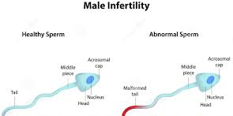
Leukemia effect on Male Reproductive System
Leukemia doesn’t affect the MRS directly, however leukemia treatment does
Chemotherapy
Radiation
The radiation and chemicals of these specific treatments cause the male’s reproductive system to possess infertility
Infertility- condition of the reproductive system from preventing fertilization of an offspring
When this takes place, the white blood cells can block the area around the testes and cause swelling

Slide 10
Chemotherapy
Chemotherapy is a treatment that works by killing multiple dividing cells. Besides killing the cancer cells, it can take out other dividing cells, such as hair follicle cells and germ cells (Sperm). The side effects then provoke hair loss, mouth sores, and infertility.
As the male’s reproductive system keeps producing these sperm cells over and over again, chemotherapy see it as a threat, the treatment believes its cancer cells that are dividing up not sperm cells. It takes action by getting rid of it. The male may still be able to produce sperm cells, but they’ll be infertile.

Slide 11
Radiation
Radiation is another treatment for Leukemia performed in the brain. The pituitary gland is located in the brain which secretes sex hormones for the male. As FSH and LH hormones are being damaged by brain radiation towards the pituitary gland, its impossible for these two hormones to be produced. Thus, resulting in no sperm stimulation and low testosterone levels
FSH- acts on the sertoli cells in the testes to promote sperm production
LH- stimulates cell production of testosterone

Slide 12
Symptoms and Risk Factors
Symptoms :
Difficulty with ejaculation
Difficulty maintaining erection
Pain or swelling
Recurrent respiratory infections
Inability to smell
Low sperm count
Risk Factors:
Having a certain medical illness
Tumor
Chronic illness
Taking certain medication for treatments
Cancer treatment:
Radiation
Chemotherapy
Surgery for treating the cancer

Slide 13
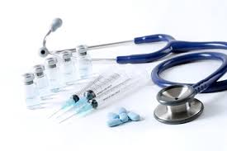
Treatments
Semen analysis to determine the number of sperm produced
Intrauterine insemination (IUI)
Sperm collected from a man to assemble a procedure of separating the healthy sperm from the rest of the semen
Performed in a lab to unite the sperm extracted from the male and the female egg in the uterus. Can also be considered as artificial insemination
Sperm donor
Hormone treatments
Increase sperm production
Surgery

Slide 14
Anemia and the Female Reproductive System

Slide 15
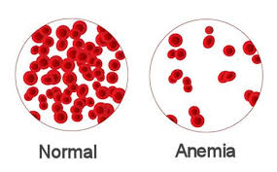
What is Anemia
Is a result from lack of red blood cells
A dysfunction of red blood cells in the body
Results in a lack of oxygen that flows to the body’s organs
Anemia is the most common blood condition that affects the U.S.
Women, young children and people with chronic diseases are at a higher risk of anemia
Factors to consider:
Certain form of Anemia are hereditary
Older adults have a higher risk in developing anemia because of poor diet and other medical conditions
Women during childbearing

Slide 16
Anemia During Pregnancy
When a woman is pregnant she is more likely to develop anemia
Having anemia means your body is not producing enough red blood cells to carry oxygen to your body tissues or the baby
During pregnancy your body produces more blood to sustain the development of your baby
Not getting enough iron or certain nutrients your body will not be able to produce enough red blood cells for your pregnancy
It’s normal to have mild anemia during pregnancy
A women can have severe anemia from low iron or vitamin levels

Slide 17
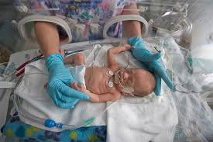
Risk Factors in Pregnancy
Iron-deficiency anemia can cause a preterm pregnancy
Preterm: labor that happens too soon (before 37 weeks)
Can cause for the women to have a premature baby
Iron-deficiency babies develop much slower and can show brain abnormalities
Slow language learning
Behavioral problems
During gestation the iron-deficiency has a bigger impact on the central nervous system

Slide 18
Symptoms
Most common symptoms of anemia during pregnancy are:
Pale skin, lips and nails
Feeling tired or weak
Dizziness
Shortness of breath
Rapid heartbeat
Trouble concentrating
Early stage of anemia will not show obvious symptoms
Many of these symptoms may be symptoms of pregnancy

Slide 19
Treatment & Prevention
Treatment:
Take iron or folic acid supplements
Including your prenatal vitamins
Your doctor may suggest to add more foods high in iron and folic acid to your diet
Or for your diet to include more Animal Foods
Meat
Eggs
Dairy products
Prevention:
Aim for iron-rich foods-three times a day:
Lean red meat, Chicken, and Fish
Iron-enriched cereals and grains
Beans and Lentils
Eggs
Foods high in vitamin C can help your body to absorb more iron:
Citrus fruits and juices
Strawberries
Kiwis
Tomatoes

Slide 20
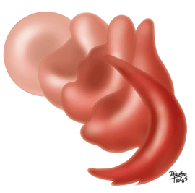
Anemia & the Respiratory and Cardiovascular System
Sickle Cell Anemia

Slide 21
What is Sickle Cell Anemia (SCA)?
A severe hereditary form of anemia in which a mutated form of hemoglobin distorts the red blood cells into a crescent shape ( ) ,or like a toenail, at low oxygen levels. Sickle cells only live to 15 days; normal hemoglobins live up to 120 days.
Sickle Cell Anemia mostly affects the Respiratory system.
Causes defective hemoglobin to form.
Normal red blood cells are round, flexible and can easily go through small capillaries. Sickle cells with it’s crescents shape cannot, instead it blocks or becomes stuck in the small capillaries causing insufficient blood flow.

Slide 22
What are the causes?
A hemoglobin molecule has 4 subunits, 2 alpha and 2 beta. People with the sickle cell disease have a mutation in chromosome 11 altering the code for beta subunit in the hemoglobin protein.
This causes the hemoglobin to not form properly, causing affected red blood cells to become rigid and give its crescent shape.
Pattern of inheritance
Autosomal Recessive Inheritance= both parents must pass on the defective (trait) form of the gene for a child to be affected.

Slide 23
What are its risk factors & symptoms?
SCA red blood cells decrease the maximum oxygen capacity of the red blood cells.
Blood flow to the lungs is significantly decreased and the lack of oxygen to the lungs can lead to painful consequences:
Pain - fever -coughing -pneumonia - necrosis: death of organ tissue cells due to failure of blood supply.
Symptoms
In infants: | In children: | In teens and adults:
Fever Swelling in hands and feet Pain in chest, abdomen, limbs and joints Nose bleeds and upper respiratory infections | Signs of anemia Fatigue and shortness in breath Irritability Jaundice | Delayed puberty Severe joint pain Progressive anemia Leg sores Gum disease Vision problems

Slide 24
What are its complications?
-Stroke= if sickle cells block blood flow to an area of your brain.
-Acute Chest Syndrome= sickle cell causes chest pain fever and difficulty breathing by blocking blood vessels in your lungs.
-Pulmonary hypertension= develop high blood pressure in your lungs.
-Organ damage= can block blood flow through blood vessels immediately depriving an organ of blood and oxygen.
-Blindness= tiny blood vessels that supply your eyes can get blocked.
-Skin Ulcers= cause open sores.
-Gallstones= breakdown of red blood cells provide a substance of bilirubin. High levels of bilirubin lead to gallstones.

Slide 25
Treatments
Treatment for SCA is usually aimed at avoiding crises, relieving symptoms and preventing complications. Treatments may include:
+Medication:
Antibiotics= penicillin for children and adults; prevents infections= pneumonia
Pain relieving= may need a stronger prescription by Doctor.
Hydroxyurea (Droxia, Hydrea), type of chemotherapy= reduce the need for blood transfusions
+Blood transfusion
+Supplemental oxygen
+Bone marrow= for severe cases
Blood transfusions can cause an excess amount of iron levels damaging your heart, liver and other organs. Solution= Deferasirox: oral medication that reduces iron levels.
Risk

Slide 26
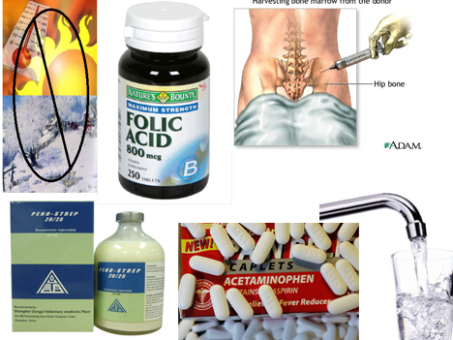
Lifestyle and home remedies
Take folic acid supplements
Choose a healthy diet
Drink plenty of water
Avoid extreme temperatures
Exercise regularly but don't over do it
Use over the counter medications with caution

Slide 27
Reference Page
"Anemia in Pregnancy: Causes, Symptoms, and Treatment." WebMD. WebMD, n.d. Web. 17 May 2016.
"American Society of Hematology." Anemia and Pregnancy. N.p., n.d. Web. 17 May 2016.
"Sickle Cell Anemia." - Mayo Clinic. Mayo Clinic Staff, 11 June 2014. Web. 17 May 2016.
"What Is Sickle Cell Disease?" National Heart, Lung and Blood Institute. N.p., 12 June 2015. Web. 17 May 2016.
"Sickle Cell Disease." Home. N.p., n.d. Web. 18 May 2016.
“Leukemia as it Affects the Nervous System” - leukemia. (n.d.). Retrieved May 17, 2016.
“Acute Lymphoblastic Leukemia Symptoms & Treatment” | Cleveland Clinic. (n.d.). Retrieved May 17,.
"Cancer & Male Infertility." University of Michigan Comprehensive Cancer Center. N.p., n.d. Web. 15 May 2016.
"Male Fertility and Cancer Treatment." Cancer Resources. N.p., n.d. Web. 15 May 2016.

