Slide 1
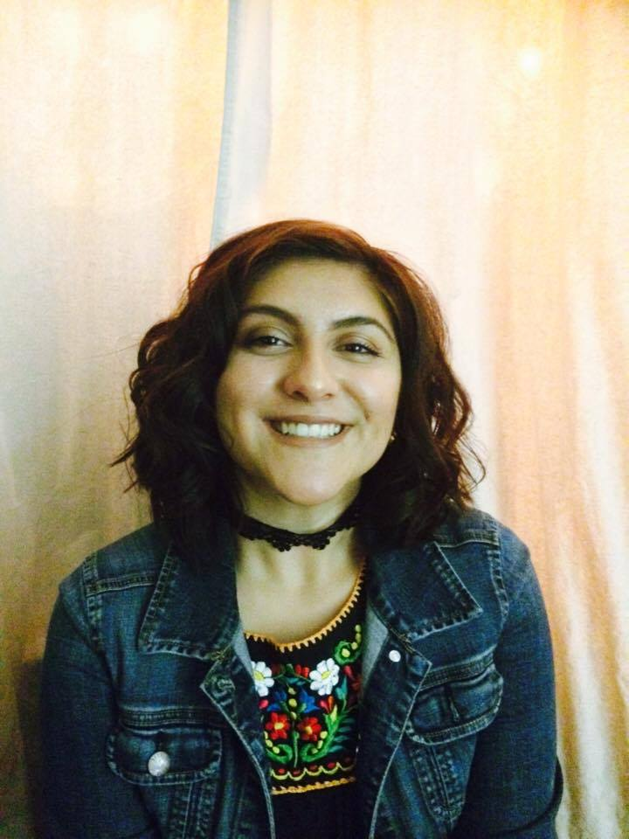
Exit Interview
Aileen Casillas

Slide 2
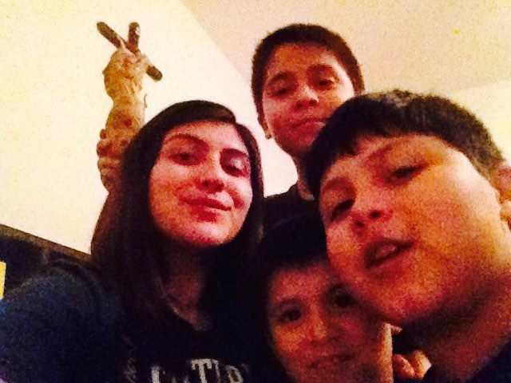
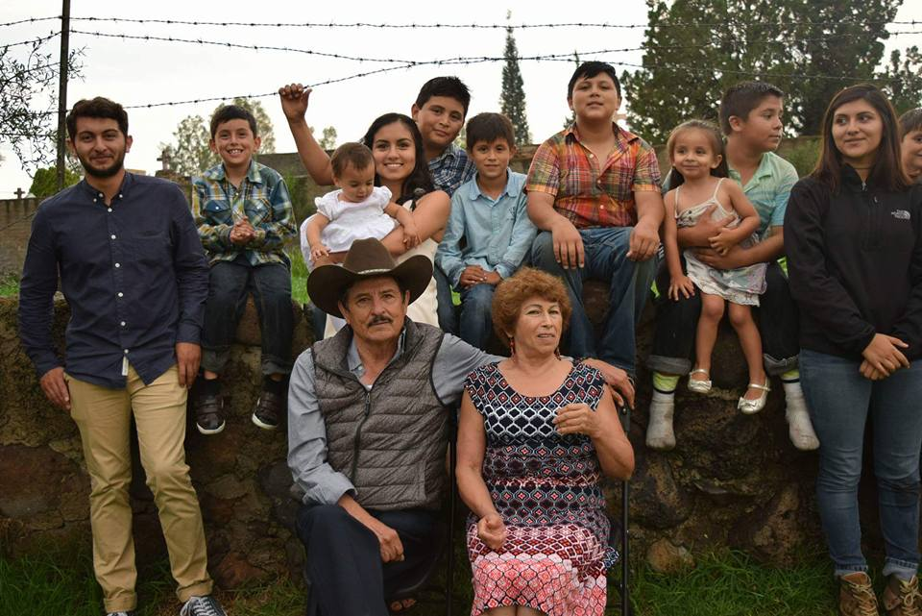
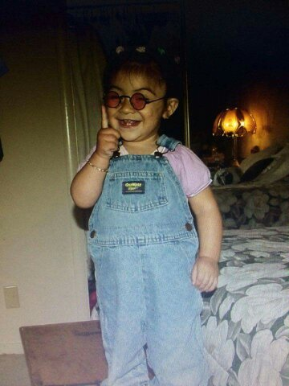
About me
Background
Born April 2nd, 1999 in Burlingame, CA
Family of 6
Oldest of 4
Raised in San Mateo, Mexico and Lindsay.
Interests/Skills
Music
K-pop
Pop
Quick learner
Personal Challenges
Bad time management
Over thinker
Low confidence

Slide 3
High School Experience
Clubs & Activities
Future Business Leaders of America - 4 years
Folkloric Club - Fashion show
Drama club
Successes
Exhibition night (junior year)
Gained some self-esteem
Challenges
PBS system
Sophomore year
Time management
Confidence
Self-esteem

Slide 4
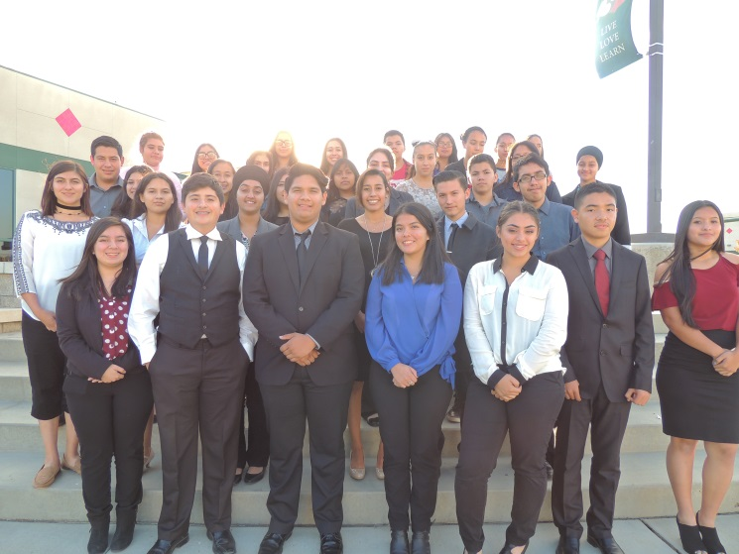
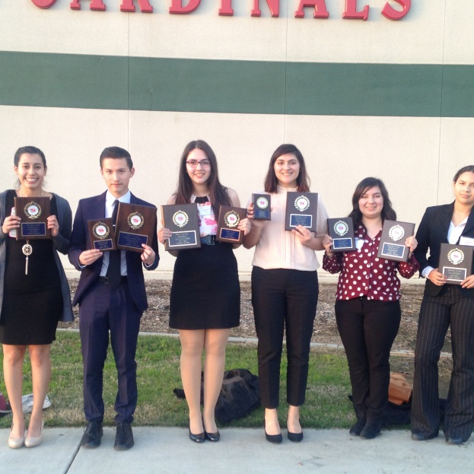
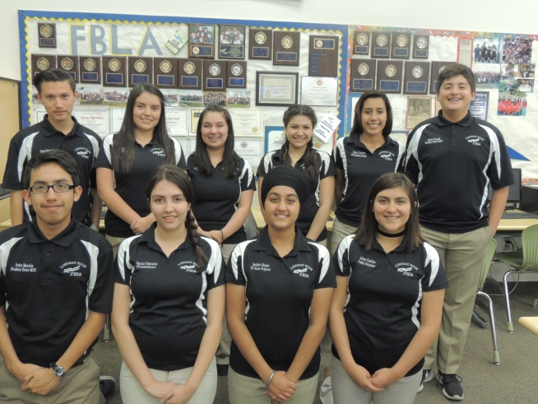
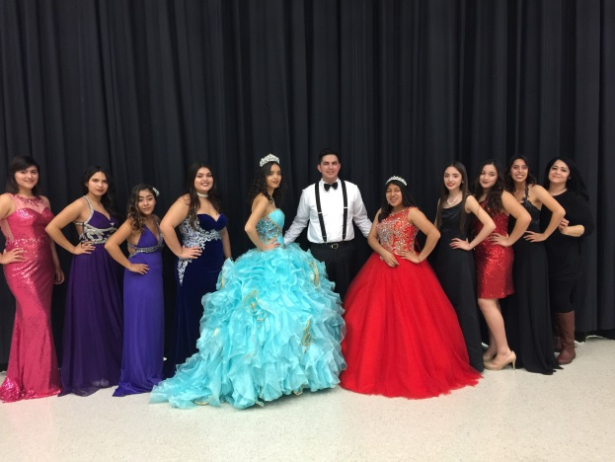
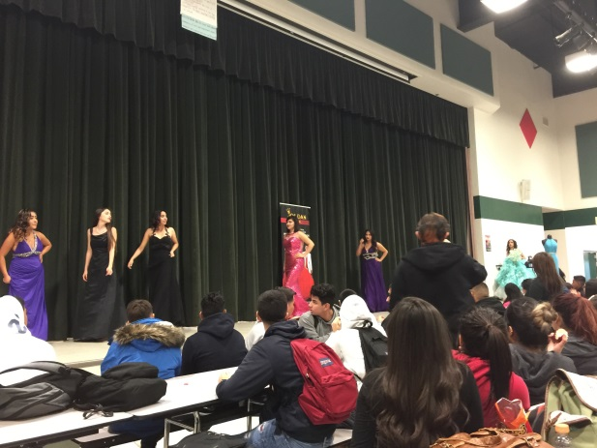
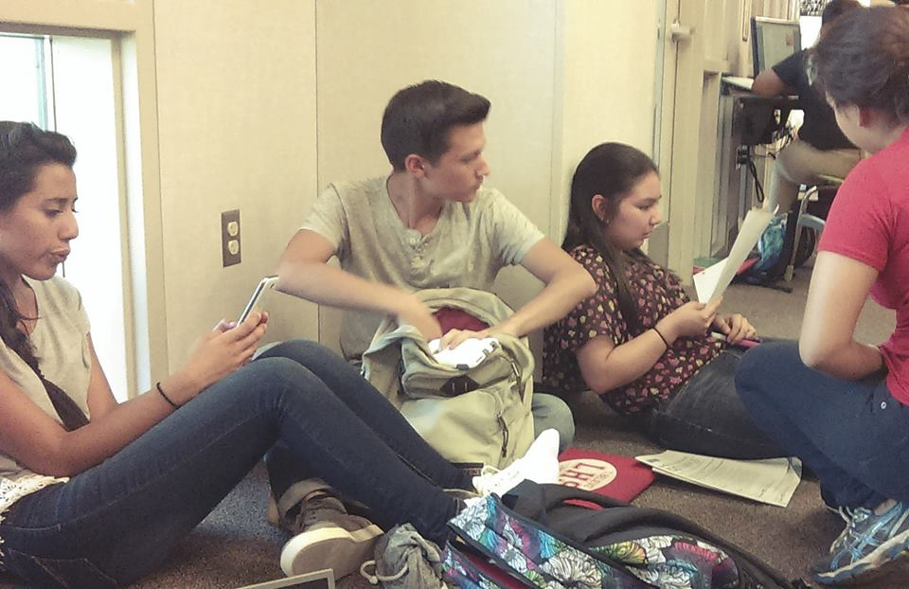
Memories

Slide 5
Job Shadow
Dr. Ricardo Gonzalez Gutierrez
General doctor at Valle de Guadalupe, Mexico
Mom was a patient
Very Interesting
Was interested in medical field & working in a clinic
This is not for me
Changed career view

Slide 6
Pathway
Medical Pathway
Was interested in working in the medical field.
Health Careers – Sophomore year
Physiology – Junior year
CNA – Senior year

Slide 7
Post High School plans
Attend COS
Major in English
Transfer in 2 years
Short term goal: transfer from COS & graduate with BA degree in English.
Long term goal: Become a ESL teacher in Mexico, Spain or South Korea.

Slide 8
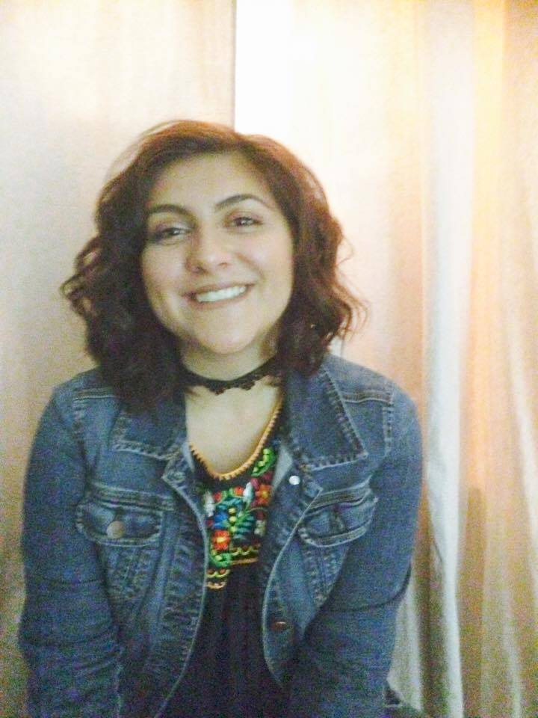
Leaving LHS
Influential people:
Mrs. Caballero – business teacher and FBLA advisor
Influenced my career choice
Mr. Traeger – Economics
PBS system
No work is completed at my pace.
Opportunities

Slide 9
Questions?

